Slide 1
Data Warehouse Architecture & Implementation Roadmap

Slide 2
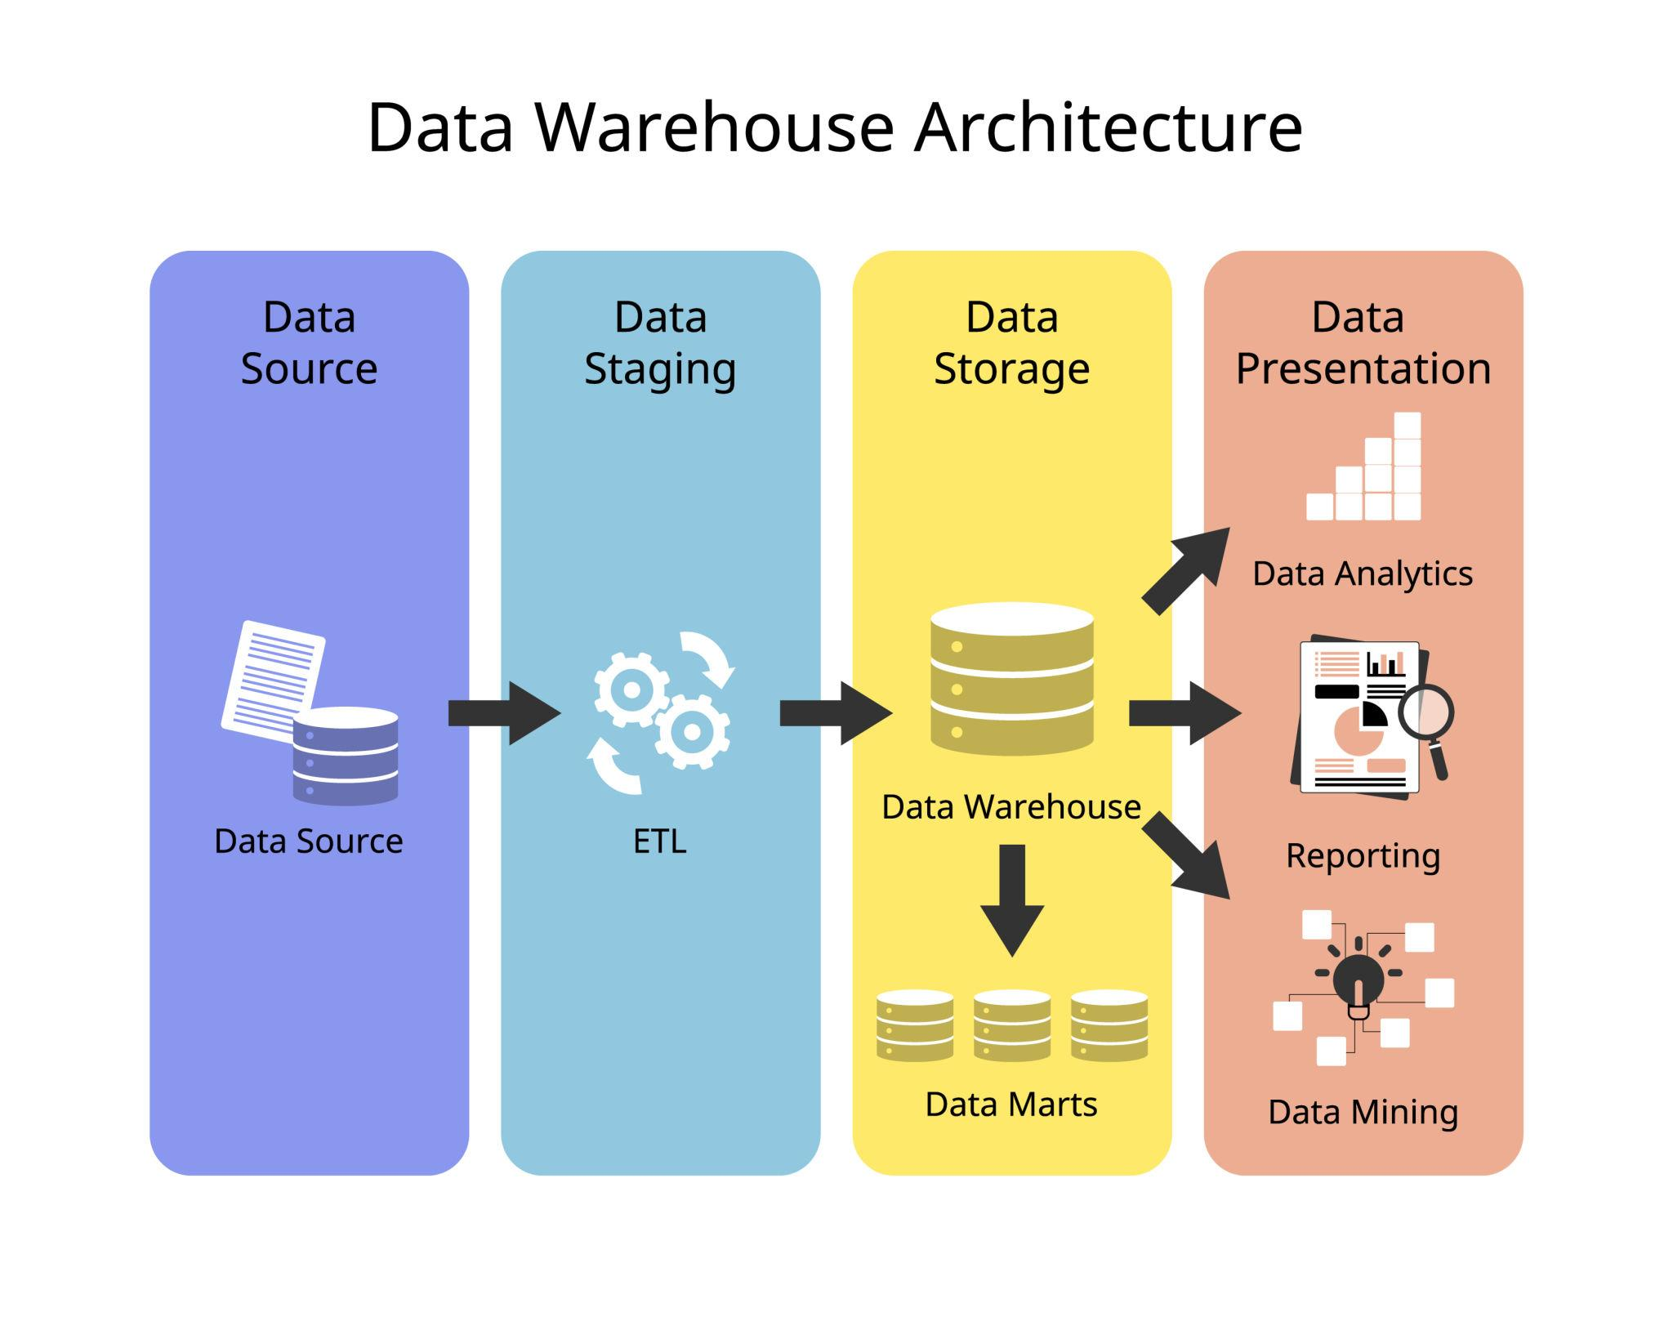
What is a Data Warehouse (DWH)?

Slide 3
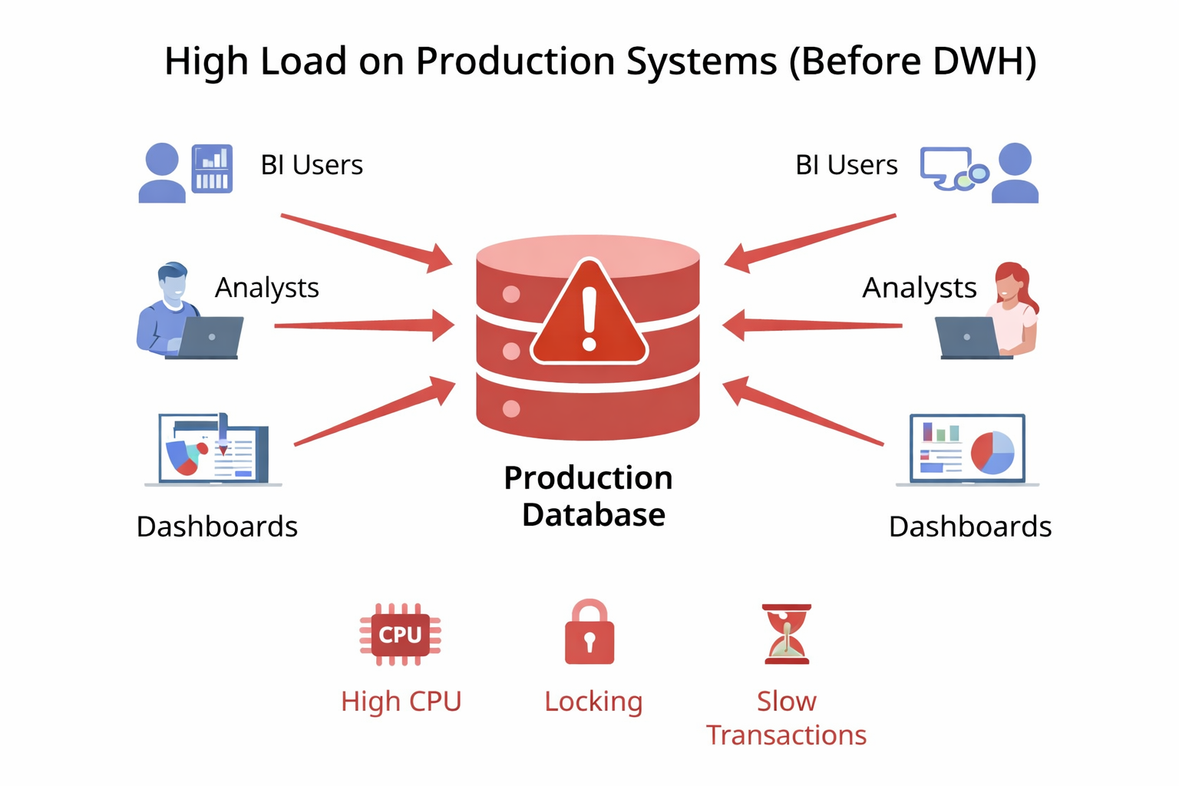
The importance of DWH

Slide 4
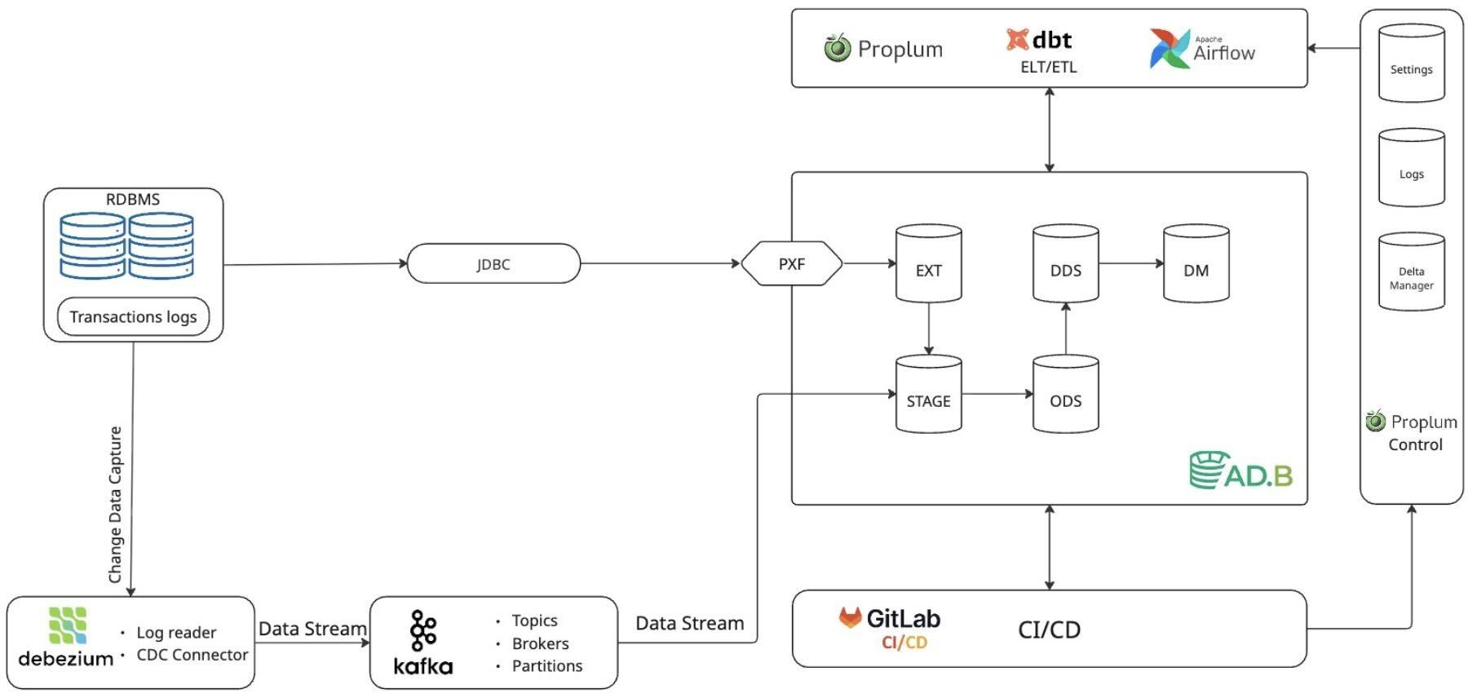
High-Level Architecture

Slide 5
3 – month plan
1st – analyzing “Xarid” database and preparing documentation in Confluence
2nd – choosing stack for DWH and modelling data quality check standards
3rd – loading tables for main reports to stg layer and to ods with normalization and data quality checks. Also check the reports in test environment

Slide 6
Done during 3 months
Documentation about tables, architecture, and reports
Integration of Kafka with “Xarid” databases and its optimization
Integration of Airflow, dbt and metabase in test environment
Start the analysis of “Spot” database
Publishing 4 main reports for ‘E-tender’, ‘Auction’, ‘Shop’ directions
Making dashboards for plan tracking and e-tender figures

Slide 7
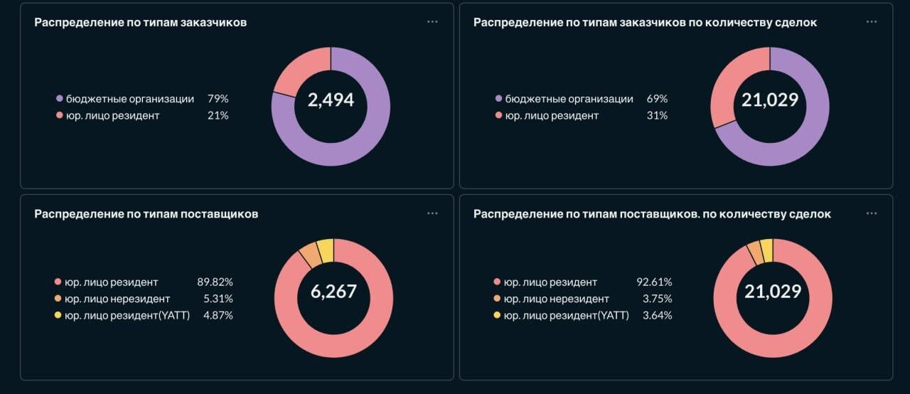
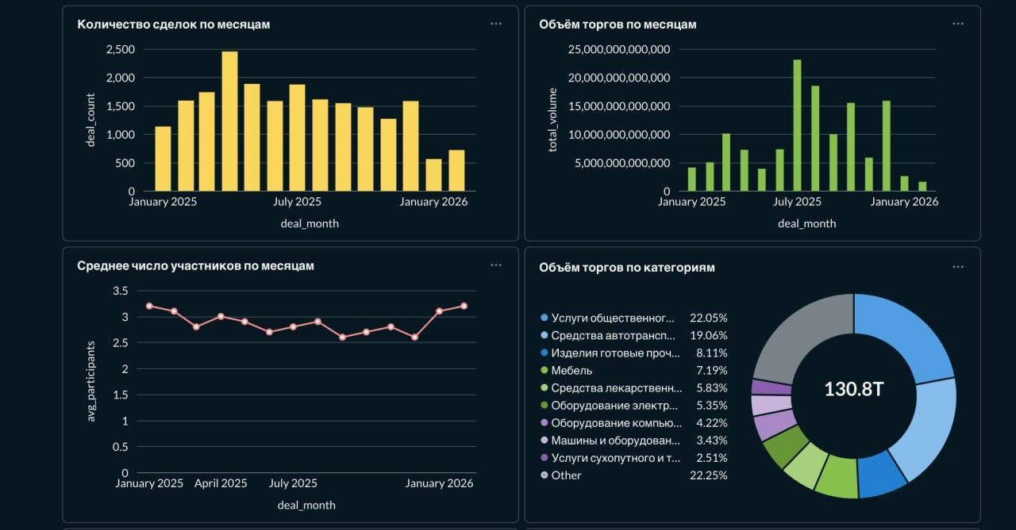
E-tender dashboards

Slide 8
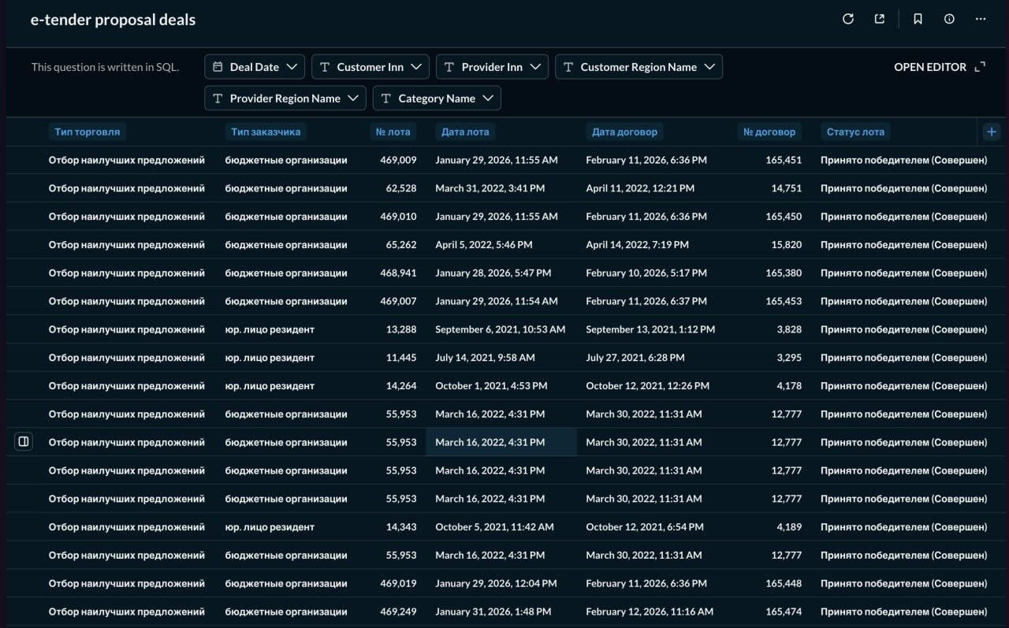
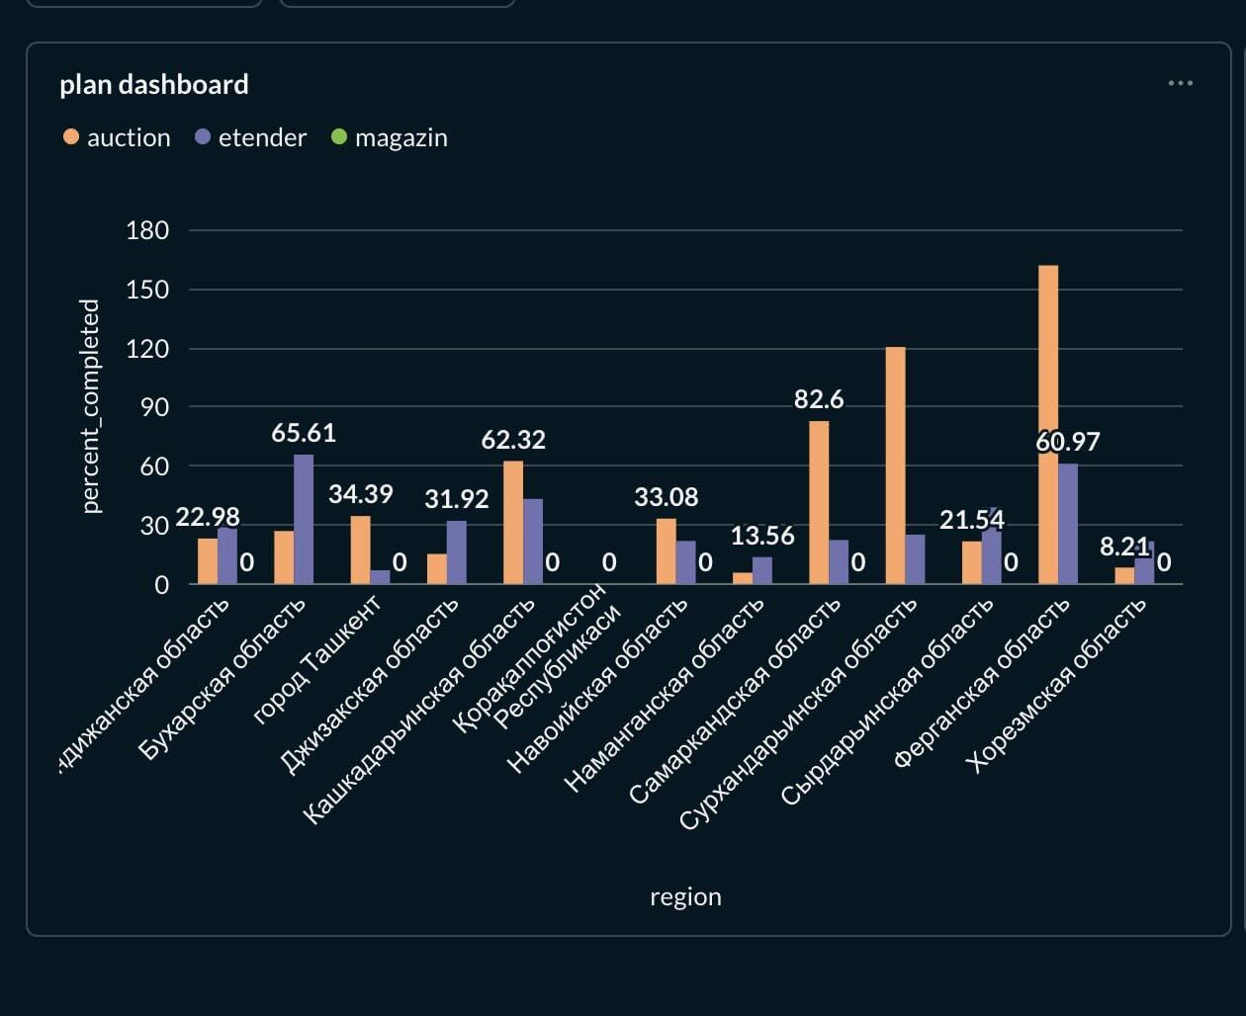
Report and plan dashboard

Slide 9
Plan for next 3 months
1st – transferring main ‘Xarid’ tables from ods layer to dds layer, deploying data quality checks and integration of dbt with airflow
2nd – transferring main ‘Xarid’ tables from dds layer to dm, publishing more ’Xarid’ dashboards to metabase and finish main reports in metabase, start analysing spot database and its reports
3rd –

Slide 10
Plan for Devops next 3 months
1st – Deployment and configuration in K8s cluster and deployment of ADB
2nd – Configuration of Debezium connectors in K8s, airflow and dbt and s3 for DWH
3rd – Deployment of Victoria metrics and Victoria logs for collection of metrics, configuration of Grafana for monitoring and basic alertmanager

